Slide 1
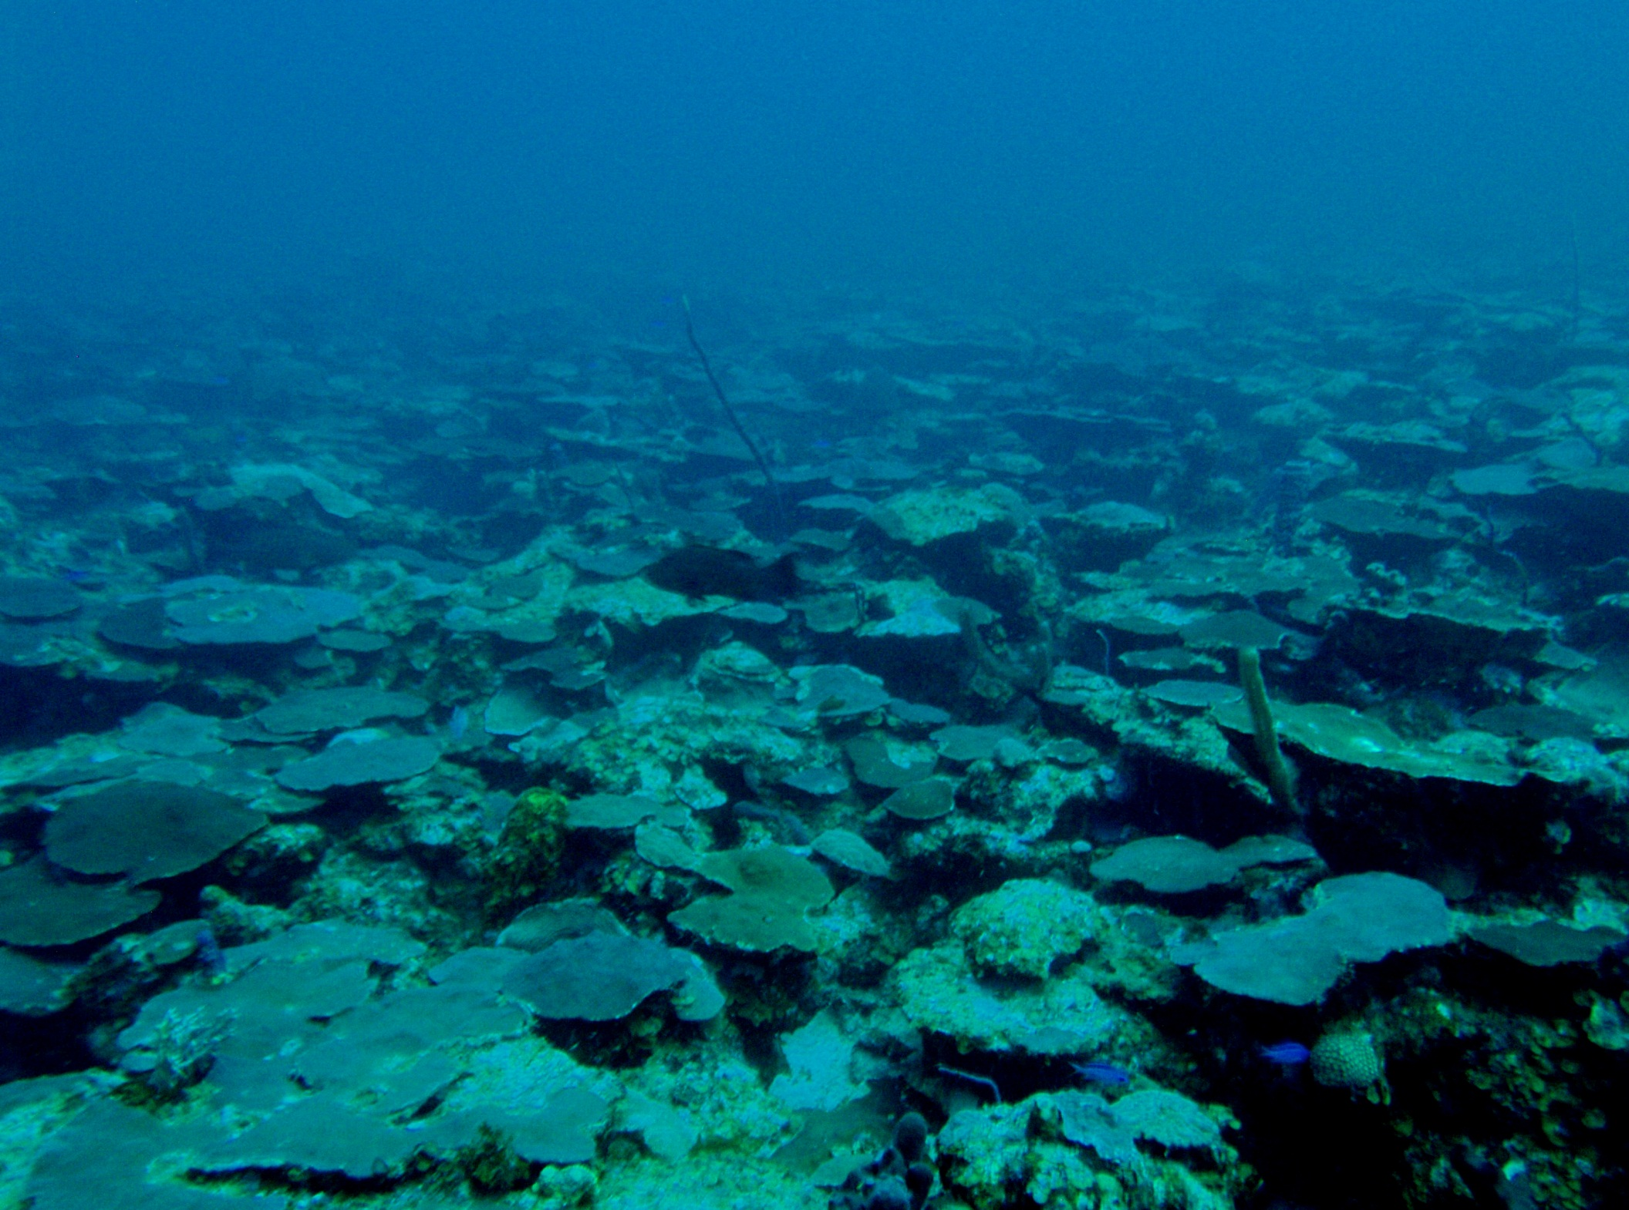
Vertical genetic connectivity in the Caribbean reef building corals Montastraea cavernosa and Porites astreoides
Co-authors: Xaymara Serrano, Iliana Baums, Tyler Smith, Ross Jones, Flavia Nunes and Andrew Baker
University of Miami, RSMAS
12th International Coral Reef symposium
July 13, 2012
USVI, photo by T. Smith
Notes:
I will discuss in this presentation mostly Mcav, since I’m close to finishing up the analyses for this species

Slide 2
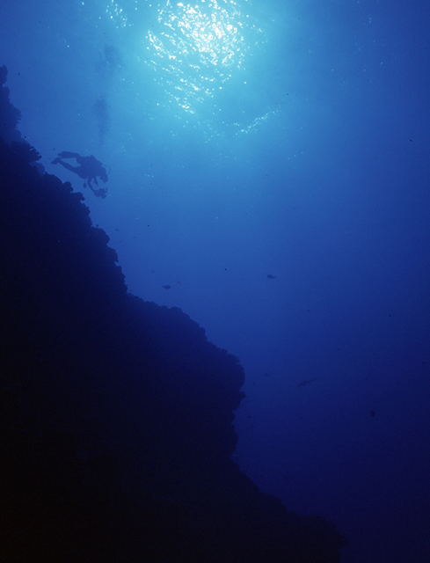
‘Deep reef refugia’ hypothesis
(1) Deep reefs (>30m) are protected from disturbances that affect shallow reefs
(2) Deep reefs may represent important sources of larvae for shallow reefs following disturbance (Bongaerts et al. 2010)
Depth-generalist species are most likely candidates
Only direct evidence found in a Pacific brooding coral (van Oppen et al. 2011)
www.mesophotic.org
Notes:
Coral reefs are in decline worldwide due to local and anthropogenic stressors. Advances in instrumentation and technical diving have also allowed a better exploration of deeper reefs. Therefore, there has been renewed interest in recent years on the role of deep reefs in aiding shallow reefs recover from disturbance. The DRRH (reviewed in Bongaerts et al. 2010) stipulates that deeper reefs are protected from disturbances that affect shallow reefs and that they are connected via larval exchange to their shallow water counterparts, potentially aiding in recovery following disturbance.
Under this assumption, depth generalist species (found in both deep and shallow habitats) are the most likely candidates since there is no point looking for connectivity in species that don’t occur in both habitats. However, tests of this hypothesis requires from high resolution techniques or markers, capable of detecting differentiation at very small spatial scales. Since larvae are very small and can’t be tracked, genetic markers are a commonly used tool for estimating gene flow and larval dispersal- and for corals, genetic markers are scarce
Finally, I have to point out that this is a relatively a new field. Not until last year the first direct evidence of vertical connectivity was provided for the Pacific brooding species Seriatopora histrix.

Slide 3
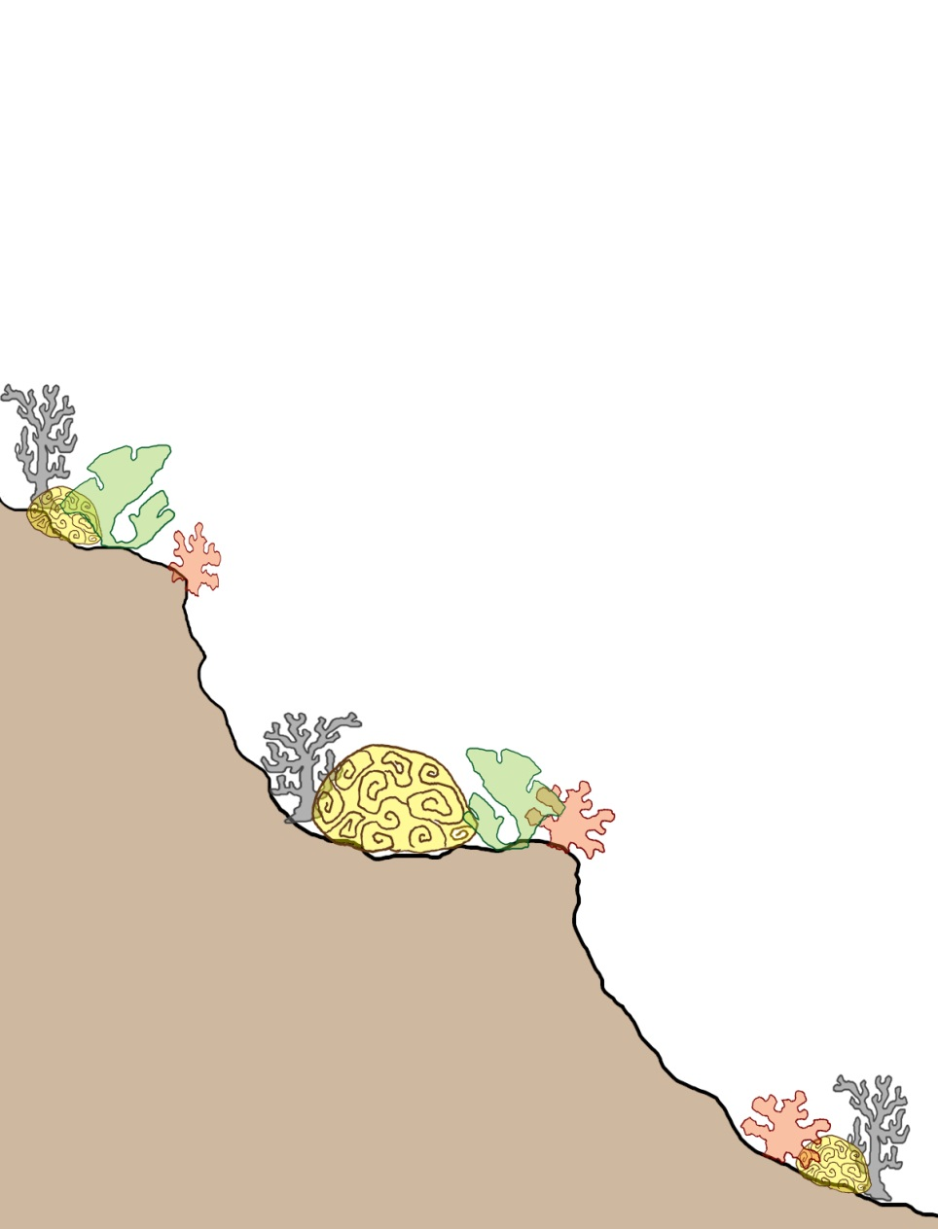
Research gaps
High resolution genetic studies aimed at studying:
  Differences among coral reproductive modes (Brooding vs. broadcasting)
  Differences among symbiont acquisition modes (Vertical vs. horizontal)
  Differences among geographic locations
  Caribbean species
Genetic studies coupled with biophysical modeling
?

Slide 4
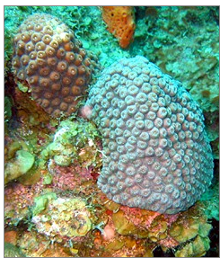
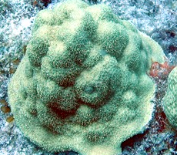
Reproductive traits of Caribbean study species
Species | M. cavernosa | P. astreoides
Reproductive mode | Broadcasting | Brooding
Sexuality | Gonochoric | Hermaphroditic and Gonochoric
Egg size | 0.6 x 0.6 mm | 0.2 x 0.1 mm
Propagules bear zooxanthellae | No | Yes
Reproductive cycles per year | 1 | 9
Depth distribution | Down to 90 m | Down to 50 m
Pelagic larval duration | Days to weeks | Minutes to days?
Potential larval dispersal | Long? | Short?
Modified from Nunes et al. 2011
Notes:
For my dissertation, I set out to test this hypothesis using Caribbean depth-generalist species that had diverse life-history reproductive strategies. I choose Past and Mcav and here are the main differences with respect to their reproductive traits. Past is a brooder, where fertilization occurs internally and planulae ready to settle is released. Conversely, Mcav is a broadcaster, and fertilization occurs externally in the water column during a mass spawning event once a year.
Gonochoric- individuals just have one of the two sexes, so can’t self-fertilize
The mode of algal symbiont transmission is also different among these species. In the case of Past, parent colonies transmit directly the symbionts, which might limit connectivity if the larvae has symbionts that are not best suited to the environment that it settles (‘high’ light vs ‘low’ light symbionts)
The PLD of these species is unknown but reports from other brooders (such as F. fragum) have observed settlement as early as 4 mins after planulae has been released. Conversely, broadcasted larvae take a minimum of 4-6 days before its even ready to settle, and thus are exposed in the water column for a longer period, potentially dispersing farther than brooders.

Slide 5
M. cavernosa microsatellite development
454 sequencing
11 markers useful for proposed analyses (in Hardy Weinberg Equilibrium)
  1 hypervariable marker (>40 alleles) useful for clone ID
  No linkage disequilibrium
Notes:
Msats are powerful genetic markers that are commonly used in pop genetics (to differentiate among individuals) due to their high degree of polymorphism.
454 sequencing outperforms traditional methods in molecular marker ID because it is more cost-effective: it provides thousands of sequences within 4 hrs (that can be screened for msats) and allows for putting multiple species in the same run.

Slide 6
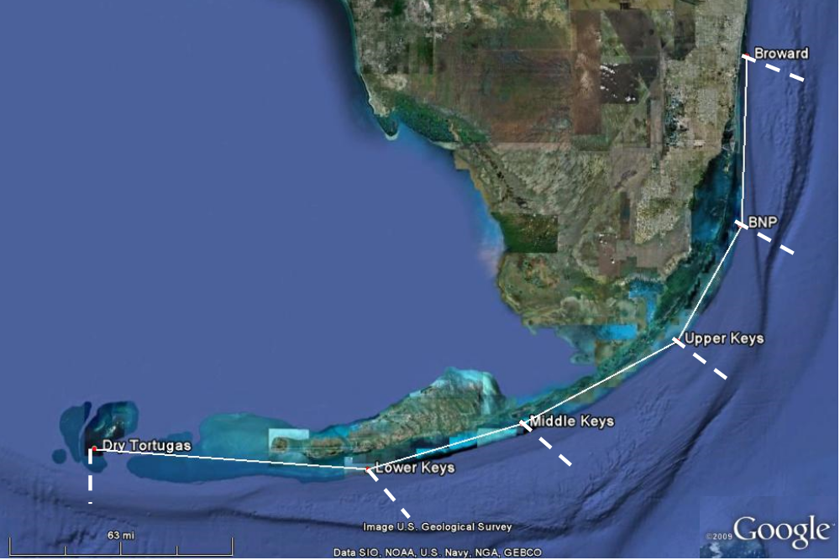
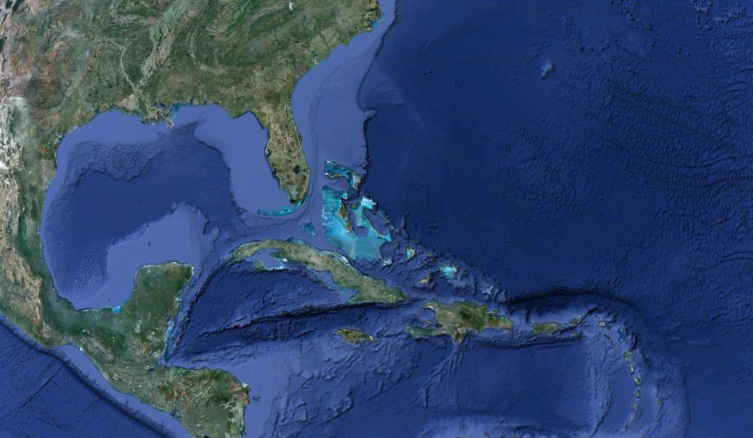

Dataset: 407 individuals successfully genotyped at 8 loci
Bermuda (n=120)
Florida (n=189)
US Virgin Islands (n=98)
Sampled depths: shallow (<10m), mid (15-20m), deep (>25m)
Notes:
Mention test of clonality, only 3 clones which were removed from analysis
Samples were collected haphazardly at these locations, targeting 3 depth zones: shallow, mid and deep. In the case of Florida, while I have collected samples across the Fl reef tract (including sites in Broward county, BNP, upper, mid and lower Keys) in shallow sites, only in the upper keys I have been able to date to collect at the 3 depth zones. Therefore, for the analyses by depth I’ll be showing I used the samples just from the upper keys.

Slide 7
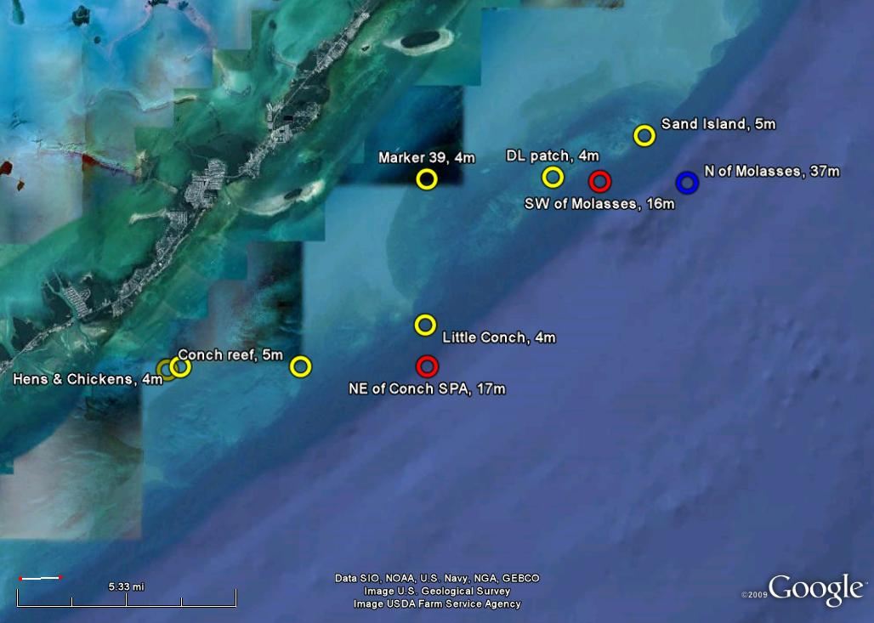
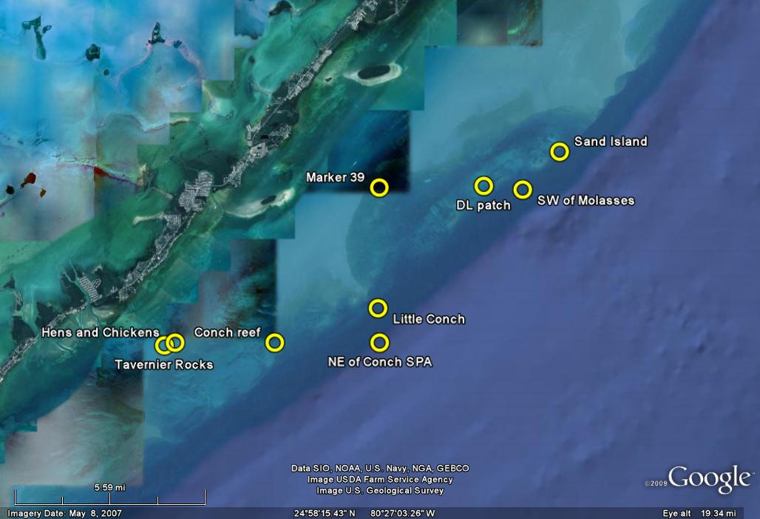
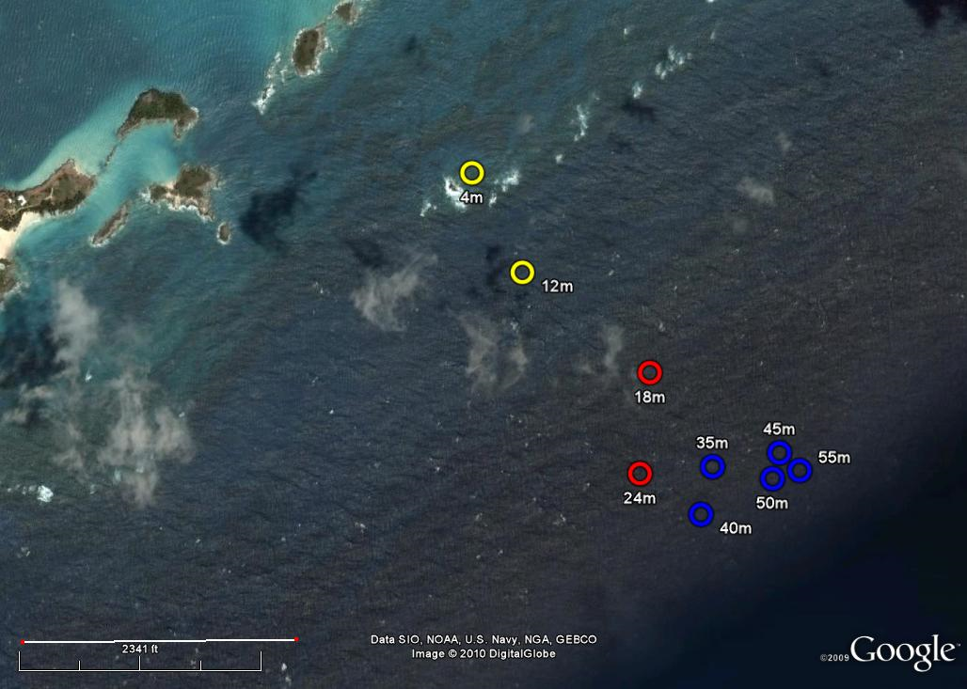
Differences among bathymetric slopes at study sites
Key Largo, Florida
Conch reef, 29m
1 mile
Bermuda
Sampled depths
Shallow (<10m)
Mid (15-20m)
Deep (>25m)
1 mile
Notes:
Specifically, I want to acknowledge the help provided by Dr. Ross Jones in BDA and Tyler Smith in the USVI. BDA offers a really interesting comparison to the Keys, because the distances between adjacent deep and shallow reefs is very small, compared to the Keys (about 1 mile from the shallowest site at 4m to the deepest at 55m).

Slide 8
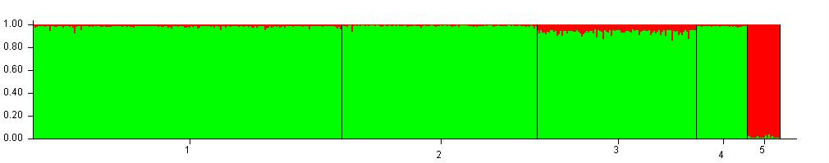
M. cavernosa shows a distinct genetic barrier between the Eastern and Western Atlantic
Number of hypothesized populations (K) = 2
Assignment probability
Florida
Bermuda
US Virgin Islands
Belize
Sao
Tome
(w Africa)
Patterns consistent with Nunes et al. (2009, 2011)
Notes:
I was also able to work a collaboration with F. Nunes, who provided me with the samples from Belize and Sao Tome (w Africa) that she used in her paper– as I was really interested in testing whether I could see the same patterns she did.
So, for the first analyses, I wanted to see if I could see the same extent of connectivity observed in the 2009/2011 papers by Nunes et al. I used the program structure, which implements a clustering method for inferring pop structure using genotype data. Briefly, this program helps estimate the most likely number of populations (K) and assigns individuals probabilistically to these populations based on their genotypes. Each bar you see is a different individual and with each, the probability that it will belong to a certain population. The higher the probability the more confidently the program can assign that individual to a particular population.
When pooling all these 5 locations, STRUCTURE determined that the most likely number of pops I have is 2, with the eastern Atlantic pops assigned to the ‘green’ and Sao Tome in W Africa assigned to red with almost 1.0 probability.
These results confirm what 2009/2011 papers found. These results also seem consistent with expectations based on the larval ecology of this species and potentially long larval duration.

Slide 9
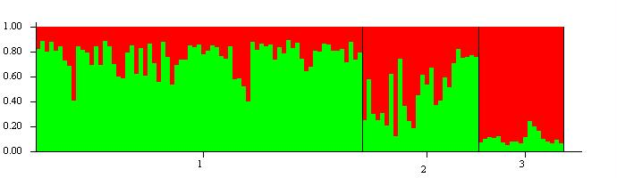
M. cavernosa results by depth
Florida (Upper Keys)
Assignment probability
Shallow (<10m)
Mid (15-20m)
Deep (>25m)
Pairwise RST
Population | Shallow | Mid
Mid | 0.074
Deep | 0.226 | 0.021
Significant genetic differentiation among deep and shallow populations
Notes:
However, my question deals with depth. Are deeper reefs isolated populations? Are they connected to their shallow water counterparts?
I tested these hypotheses at each of my three study locations, first of which I will describe is Florida.
Structure again suggests that the most likely populations are 2. Shallow water individuals were mostly assigned to the green pop, whereas deep individuals were mostly assigned to the red. I’m in the process of using assignment tests to be able to determine the direction of gene flow (deep to shallow vs. shallow to deep). These results were also confirmed by pairwise Rst, which are analogous to Fst measures of genetic differentiation. These stats go from 0-1 and the higher the value, the more evidence for genetic differentiation among that pair of pops being tested. Indeed, the deep pop appears significantly different from the shallow pop.
Mcav appears connected horizontally by up almost 2000kms, however, appears structured by depth within 10’s of kms in Florida.
You might wonder why I couldn’t see the differentiation when pooling all the FL samples in the location analyses- what I think is going on is that the Sao Tome signal is so strong that any weak signals at any of the locations will disappear.

Slide 10
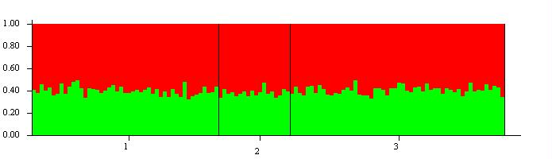
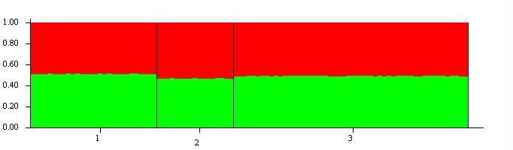
M. cavernosa results by depth
Bermuda
Assignment probability
Shallow (<10m)
Mid (15-20m)
Deep (>25m)
US Virgin Islands
Assignment probability
Shallow (<10m)
Mid (15-20m)
Deep (>25m)
Notes:
Now, looking at BDA or USVI an even more interesting picture appears. Both sites appear to be fully mixed among depths, with no evidence for genetic structuring with depth. Again these results support the DRRH and highlight the importance of the geographic location in influencing the patterns observed.

Slide 11
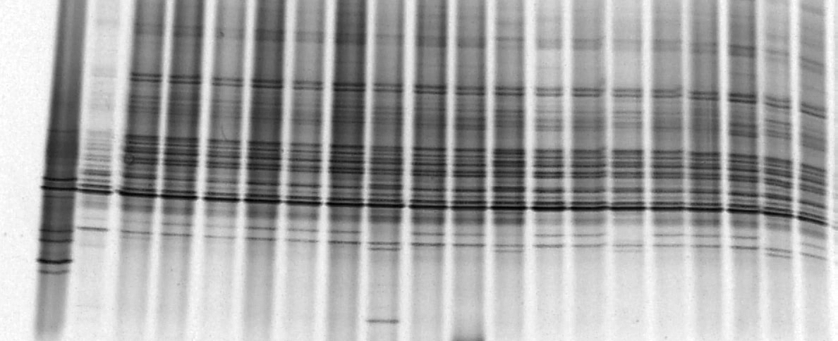
No depth zonation in the algal symbionts of M. cavernosa
marker
DGGE typical profile
C3
D1a
At all locations, shallow and deep colonies are dominated by Symbiodinium C3
  Ecology of symbiosis is NOT a limiting factor for vertical connectivity in this species
Notes:
Observations of D1a just in shallow are very important because D1a has been thought to confer thermal tolerance to corals. It is possible that Florida is a more disturbed environment (compared to BDA or USVI) and as such there is more variability in symbiont types as well.
It is possible that there is background D1a in mid/deep colonies, that would not show in the DGGEs, as this techniques gives mostly dominant types. This is a very interesting question I addressed with qPCR, which is a more sensitive technique

Slide 12
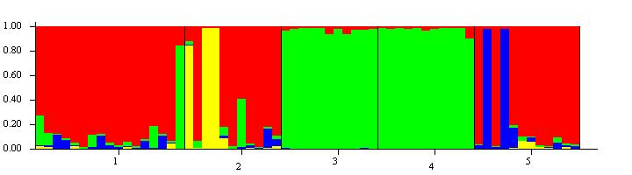
P. astreoides preliminary results
To date, 5 markers developed useful for proposed analyses (in HWE)
Combined my markers with 6 markers recently developed by Matz lab (UC Austin)
FL shallow
FL mid
BDA shallow
BDA mid
USVI shallow
RESULTS suggest the presence of at least 4 populations in the Caribbean

Slide 13
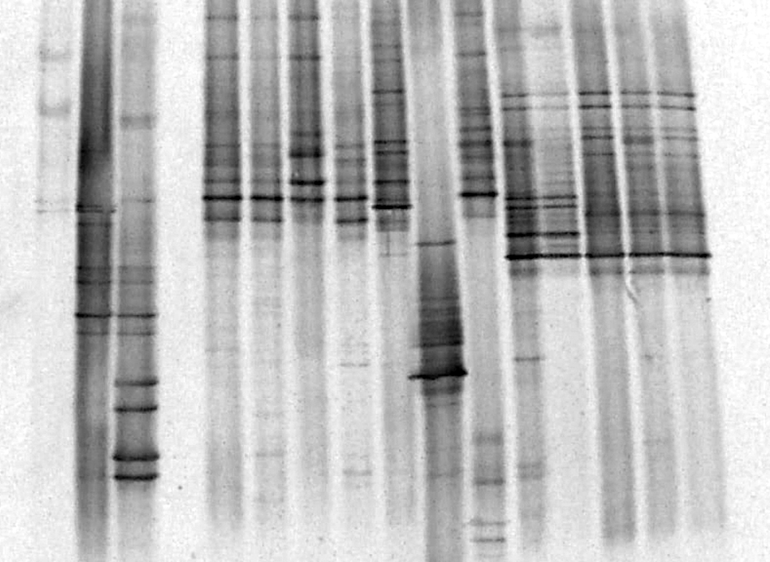
Depth zonation in algal symbionts of P. astreoides
DGGE profile
A4
C1
B1
Florida shallow/mid
Florida deep
Preliminary analyses show differences in algal symbionts by depth
  Maternal transmission of symbionts might further limit connectivity in brooding species
Notes:
Past algal symbionts different with depth, yet to confirm identity!
The coral-symbiont interaction further complicates the study of population structure, dispersal and connectivity in corals because processes of symbiont transfer may impose limitations to the colonization and survival of coral offspring within certain habitats. For example, brooding coral species may be limited in their ability to settle outside the direct parental range if depth-specific symbionts are transferred to the offspring.

Slide 14
Conclusions
Results for M. cavernosa suggests no significant genetic differentiation among populations separated by depth except in Florida
  1st evidence of vertical connectivity in a Caribbean coral or in a broadcasting spp.
  No evidence for depth zonation in algal symbionts of M. cavernosa, as most colonies hosted Symbiodinium C3
Preliminary analyses for P. astreoides show significant genetic differentiation by geographic location and depth, as well as differences in algal symbionts
  Limited role of brooding species in shallow reef recovery?
Overall, findings partly support the Deep Reef Refugia Hypothesis but highlight the importance of both reproductive traits and geographic location

Slide 15
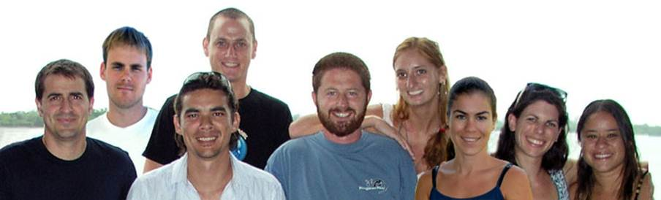
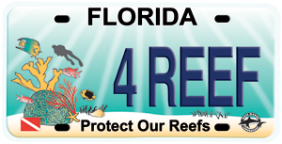



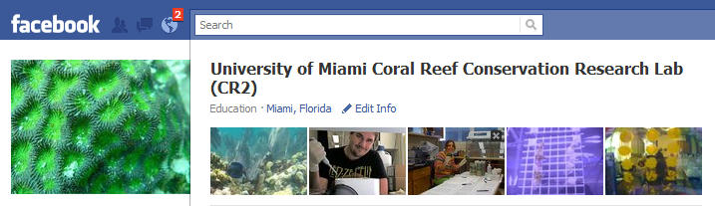
Thank you all…
Advisor
Dr. Andrew Baker
Committee members
Dr. Diego Lirman
Dr. Claire Paris
Dr. Margie Oleksiak
Dr. Margaret Miller
Dr. Iliana Baums
Lab members
Ross Cunning
Paul Jones
Herman Wirshing
Rachel Silverstein
Rivah Winter
Collaborators
Tyler Smith (USVI)
Kevin Feldheim
Ross Jones (BIOS)
Flavia Nunes
Carly Kenkel
Sarah Davies
Funding
Mote’s “Protect Our Reefs” grant
McKnight Doctoral Fellowship
NOAA’s LMRCSC
Interns
Marisa Moon
Katie O’ Reilly
Naoko Kurata
Special thanks
Alexis Torres
Baums lab (PSU)
Matz lab (UC Austin)
RSMAS dive office
Dione Swanson
Check out our lab FB page!!!

Slide 16
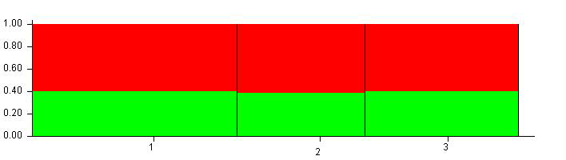
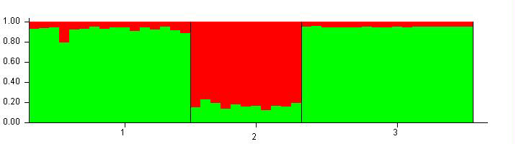
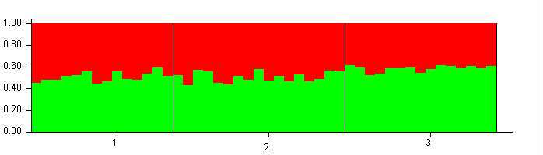
M. cavernosa runs by depth
All locations shallow (<10m) run
Assignment probability
FL shallow
BDA shallow
USVI shallow
All locations mid-depth (15-20m) run
Assignment probability
FL mid
BDA mid
USVI mid
All locations deep (>25m) run
Assignment probability
FL deep
BDA deep
USVI deep

Slide 17
Ongoing & future work:
Complete analyses for M. cavernosa
Complete genetic characterization of Symbiodinium in P. astreoides
Analyses of population structure and connectivity for P. astreoides
Expanded geographic sampling design along the Florida reef tract
Biophysical modeling of M. cavernosa and P. astreoides

Slide 18
Direction of gene flow: Shallow to deep or deep to shallow?
Among depths
Pop 1
Pop 2
Pop 3
Shallow
Mid
Deep
Sinks
Pop 1
Shallow
0.837
0.119*
0.067
Sources
Pop 2
Mid
0.157*
0.871
0.240*
Pop 3
Deep
0.006
0.010
0.694
* Denotes values that represent >5% immigration rates
Notes:
Questions to ask Iliana- should I average the values across runs? How do I decide which parameters to use?

Slide 19
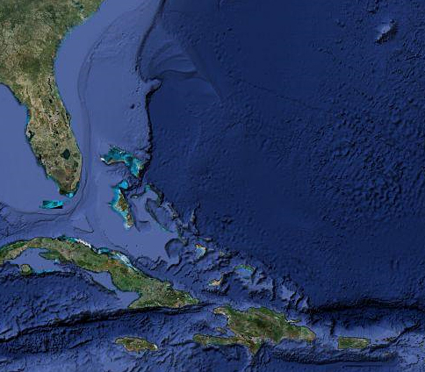
Bermuda (n=120)
Florida (n=189)
US Virgin Islands
(n=98)

Slide 20
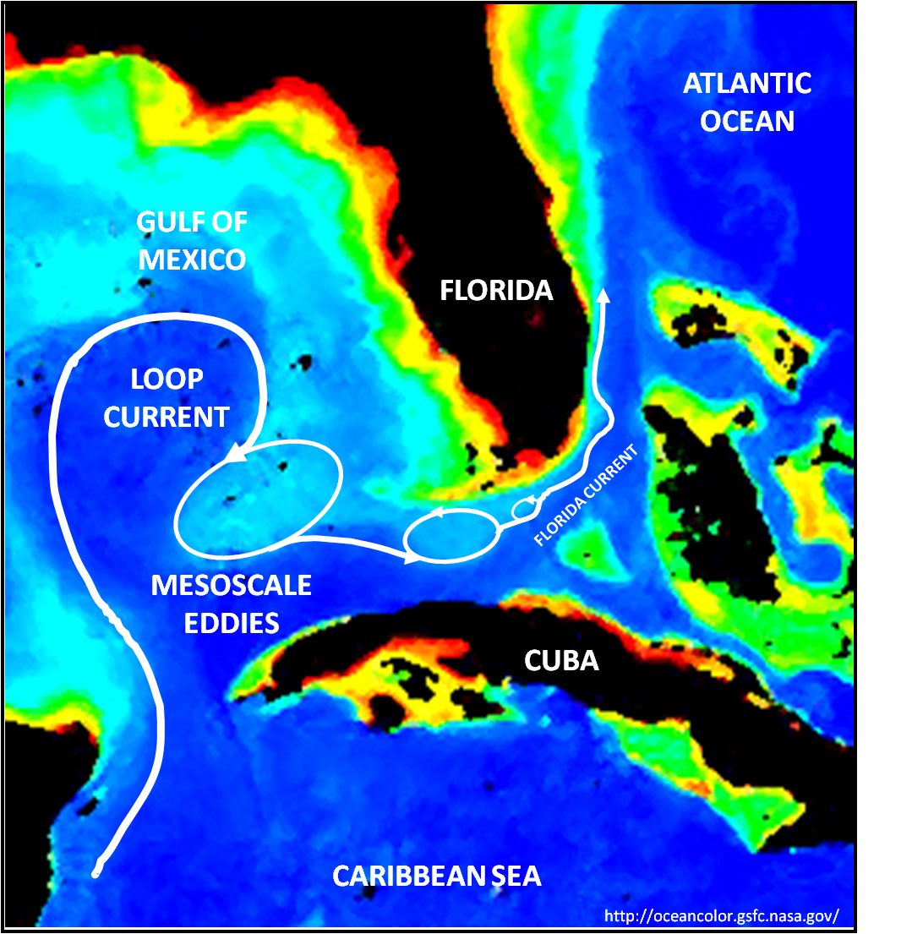
Courtesy of Sponaugle lab

Slide 21
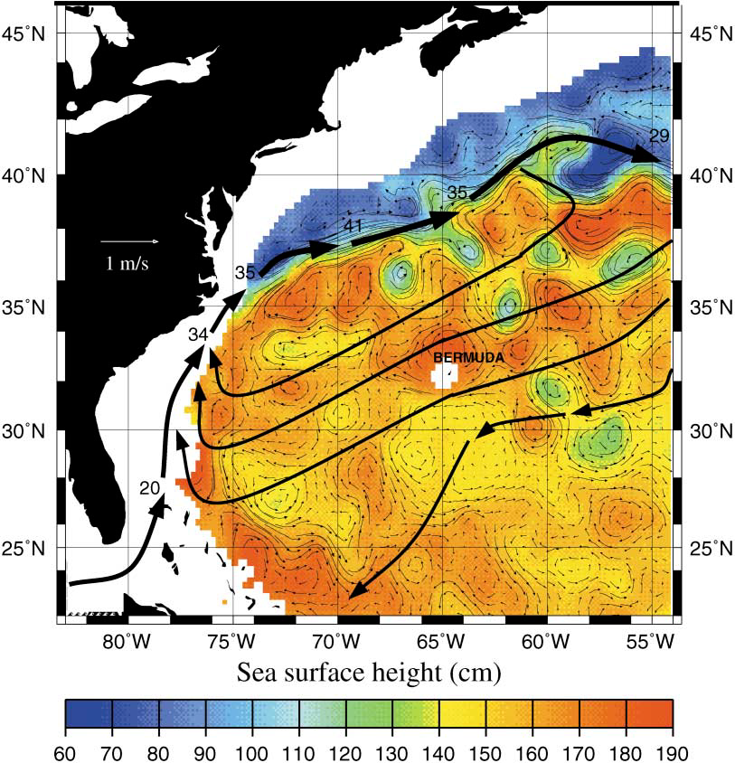
Steinberg et al. 2001

Slide 22
Incorporating biophysical modeling to our study
Collaboration with Dr. Claire Paris (RSMAS)
900m resolution ocean circulation model for the FL Keys
Can generate dispersal probabilities of mixing between shallow and deep
Key Largo, FL
N=53
N=48
N=31
N=19
N=39
N=36
N=46
N=25
N=87
1 mile
N=65

Slide 23
Expected benefits from this study
Results show that some reefs have the potential to recover over short vertical distances, but it depends on the species involved
Results are critical for managers who are operating under the assumption that climate change and other impacts are unlikely to improve in the short term
Significant vertical connectivity suggests:
  Need for re-assessment of current level of protection afforded to deep reefs
  Important for the re-design of MPAs
    Results could provide the rationale for extending no-take zones deeper
Notes:
Results of this research are expected to help determine whether reef coral populations have the potential to recover over short vertical distances, rather than long horizontal distances. If nearby deep reefs have greater potential to replenish shallow reefs than distant shallow reefs, this finding would help identify new strategies for management designed to maximize reef recovery and diversity (i.e., the protection of deeper reefs) and actions we might undertake that would facilitate or maximize this process.

Slide 24
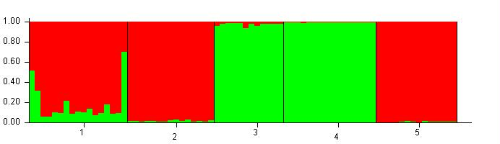
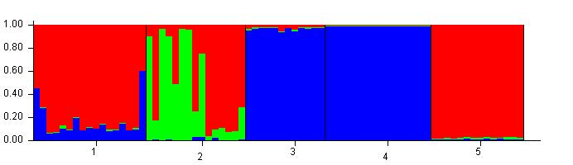
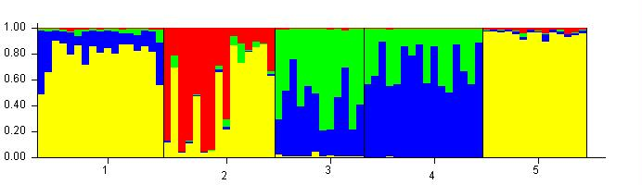
P. astreoides preliminary results
All locations and depths (N=95)
Assignment probability
K=2
FL shallow
BDA shallow
BDA mid
USVI shallow
FL mid
Assignment probability
K=3
FL shallow
BDA shallow
BDA mid
USVI shallow
FL mid
K=4
Assignment probability
FL shallow
BDA shallow
BDA mid
USVI shallow
FL mid
Notes:
Past algal symbionts different with depth, yet to confirm identity!

Slide 25
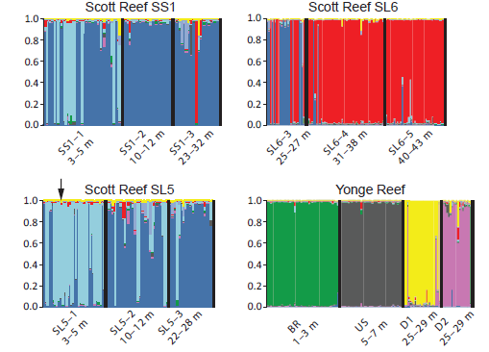
Brooding coral Seriatopora hystrix
Van Oppen et al. 2011

Slide 26
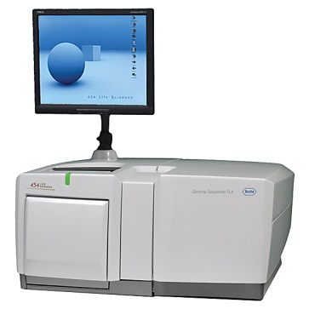
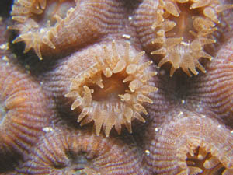
Microsatellite development:
Coral for marker development
454 sequencing
Identify candidate sequences
Reduce symbiont contamination
Screen for variability
Analysis of population structure & connectivity!
  Confirm host-specificity
PCR optimization
Test for conformity to
population genetic models
Notes:
Therefore, I decided to use and develop microsatellites, as they are very powerful markers due to their high degree of polymorphism. However, few coral microsatellites are available to date, in part because it has been very difficult to obtain a high number of markers for coral species, due to DNA contamination with algal symbionts and failure to conform to expectations of pop gen models.
To alleviate some of these limitations, we decided to use “next generation” 454 DNA sequencing to more effectively develop additional microsatellite loci for a few depth-generalist coral species. Some of the advantages are that this novel technique will provide thousands of DNA sequence reads within one 4-hr run, and allow including multiple species within one run, significantly reducing the overall costs compared to traditional sequencing methods.
In last year’s seminar, I went into explaining in detail how I used the data from the 454 run to develop msats and the process of PCR-optimizing the candidates I had to yield a set of msat loci I could use for my proposed analyses of pop structure and connectivity. The focus of the rest of the talk will be in the results I got using this markers.

Slide 27
M. cavernosa allele diversity & tests of HWE: FL
Population | Marker | 29 | 41 | 46 | 4 | 18 | 65 | 49 | 97
FL shallow | N | 16 | 16 | 15 | 16 | 16 | 16 | 16 | 16
 | Na | 8 | 8 | 2 | 16 | 9 | 4 | 5 | 5
 | He | 0.819 | 0.831 | 0.433 | 0.938 | 0.794 | 0.381 | 0.713 | 0.756
 | Ho | 0.813 | 0.813 | 0.467 | 1.000 | 0.750 | 0.375 | 0.688 | 0.875
 | P-value | ns | ns | ns | ns | ns | ns | ns | ns
FL mid | N | 15 | 14 | 12 | 15 | 15 | 15 | 15 | 15
 | Na | 8 | 4 | 3 | 21 | 10 | 5 | 9 | 5
 | He | 0.827 | 0.650 | 0.233 | 0.973 | 0.880 | 0.620 | 0.847 | 0.720
 | Ho | 0.733 | 0.643 | 0.250 | 1.000 | 0.867 | 0.733 | 0.800 | 0.600
 | P-value | ns | ns | ns | ns | ns | ns | ns | ns
FL deep | N | 14 | 15 | 14 | 14 | 13 | 15 | 12 | 12
 | Na | 7 | 6 | 2 | 14 | 7 | 3 | 10 | 7
 | He | 0.614 | 0.733 | 0.200 | 0.929 | 0.838 | 0.193 | 0.900 | 0.783
 | Ho | 0.500 | 0.733 | 0.071 | 0.786 | 0.462 | 0.067 | 0.750 | 0.667
 | P-value | ns | ns | ns | ns | *** | * | ns | *
* Denotes p<0.05, *** denotes p<0.001

Slide 28
M. cavernosa allele diversity & tests of HWE: BDA
Population | Marker | 29 | 41 | 46 | 4 | 18 | 65 | 49 | 97
BDA shallow | N | 10 | 10 | 10 | 10 | 10 | 10 | 10 | 10
 | Na | 5 | 5 | 3 | 12 | 9 | 1 | 6 | 4
 | He | 0.690 | 0.780 | 0.350 | 0.930 | 0.880 | 0.000 | 0.520 | 0.550
 | Ho | 0.800 | 0.900 | 0.400 | 0.800 | 0.900 | 0.000 | 0.600 | 0.500
 | P-value | ns | ns | ns | ns | ns | na | ns | ns
BDA mid | N | 11 | 10 | 11 | 11 | 11 | 11 | 11 | 11
 | Na | 4 | 6 | 3 | 11 | 7 | 1 | 5 | 5
 | He | 0.691 | 0.760 | 0.255 | 0.909 | 0.855 | 0.000 | 0.618 | 0.618
 | Ho | 0.727 | 0.900 | 0.273 | 0.909 | 0.818 | 0.000 | 0.636 | 0.636
 | P-value | ns | ns | ns | ns | ns | na | ns | ns
BDA deep | N | 17 | 11 | 18 | 11 | 18 | 17 | 1 | 14
 | Na | 5 | 9 | 2 | 13 | 8 | 4 | 1 | 5
 | He | 0.635 | 0.873 | 0.206 | 0.945 | 0.844 | 0.171 | na | 0.664
 | Ho | 0.412 | 0.636 | 0.222 | 0.909 | 0.611 | 0.176 | na | 0.857
 | P-value | ns | * | ns | ns | *** | ns | na | ns
* Denotes p<0.05, *** denotes p<0.001
Green – marker failed to amplify in this population

Slide 29
M. cavernosa allele diversity & tests of HWE: USVI
Population | Marker | 29 | 41 | 46 | 4 | 18 | 65 | 49 | 97
USVI shallow | N | 11 | 9 | 10 | 10 | 11 | 11 | 10 | 9
 | Na | 5 | 4 | 3 | 13 | 8 | 3 | 7 | 4
 | He | 0.709 | 0.700 | 0.470 | 0.960 | 0.873 | 0.327 | 0.820 | 0.478
 | Ho | 0.727 | 0.889 | 0.400 | 0.900 | 0.455 | 0.364 | 0.500 | 0.556
 | P-value | ns | ns | ns | ns | * | ns | * | ns
USVI mid | N | 17 | 17 | 16 | 17 | 17 | 17 | 17 | 13
 | Na | 6 | 6 | 2 | 17 | 10 | 2 | 8 | 5
 | He | 0.765 | 0.671 | 0.225 | 0.935 | 0.894 | 0.371 | 0.629 | 0.715
 | Ho | 0.706 | 0.824 | 0.250 | 0.765 | 0.647 | 0.353 | 0.471 | 0.692
 | P-value | ns | ns | ns | *** | * | ns | * | ns
USVI deep | N | 15 | 15 | 14 | 14 | 14 | 15 | 15 | 13
 | Na | 6 | 7 | 3 | 17 | 8 | 3 | 6 | 7
 | He | 0.693 | 0.787 | 0.407 | 0.957 | 0.886 | 0.467 | 0.640 | 0.708
 | Ho | 0.733 | 0.667 | 0.500 | 0.857 | 0.786 | 0.533 | 0.733 | 0.692
 | P-value | ns | ns | ns | * | ns | ns | ns | ns
* Denotes p<0.05, *** denotes p<0.001

Slide 30
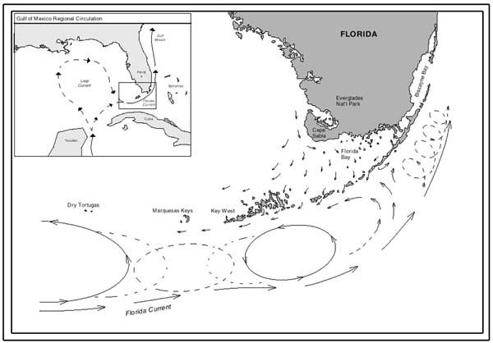
What could explain the patterns observed in Florida?
http://oceanexplorer.noaa.gov
Notes:
Map showing current patterns throughout the Florida Keys. Note how clockwise and counterclockwise gyres exist shoreward of the Florida Current. These tend to carry larvae and spores from place to place throughout the region. Knowing where parent stocks are located and understanding how currents transport their young allow resource managers to protect important areas before they become overharvested.

